Slide 1
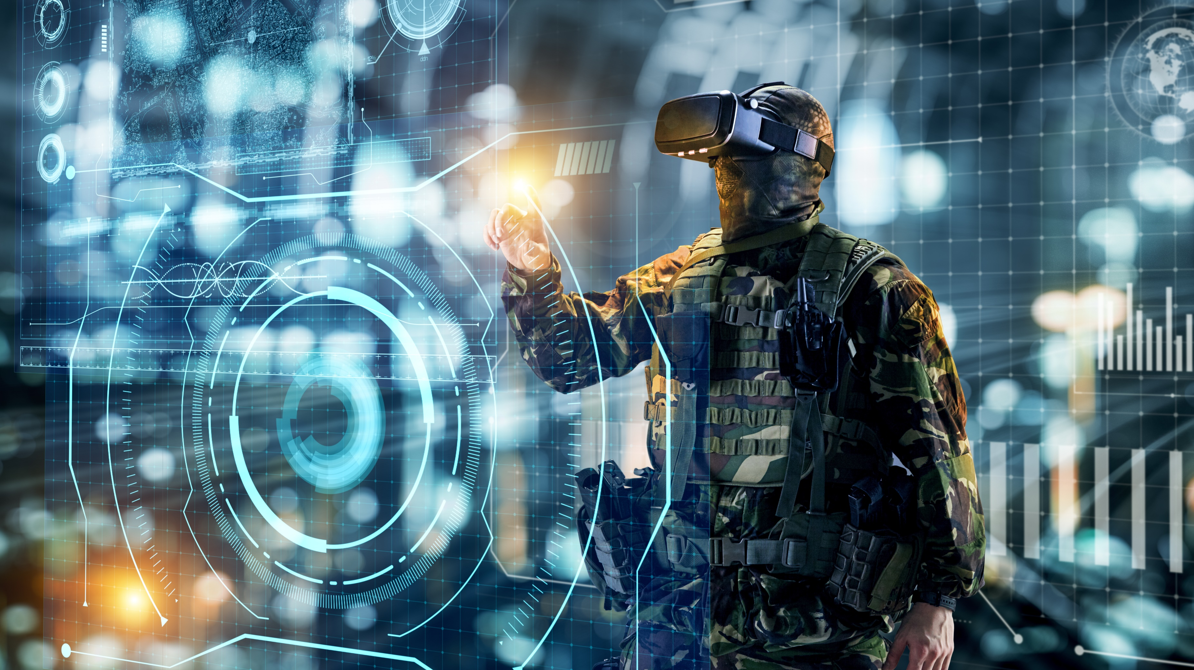
Military Technology
The Uses and History

Slide 2
Importance
Technology has proven to play a vital role in modern military operations, profoundly impacting the effectiveness, efficiency, and safety of armed forces worldwide
The main points that will be spoken about today will revolve around how it used in:
Communication
Precision Targeting
Situational Awareness
Cyberattack/defense

Slide 3
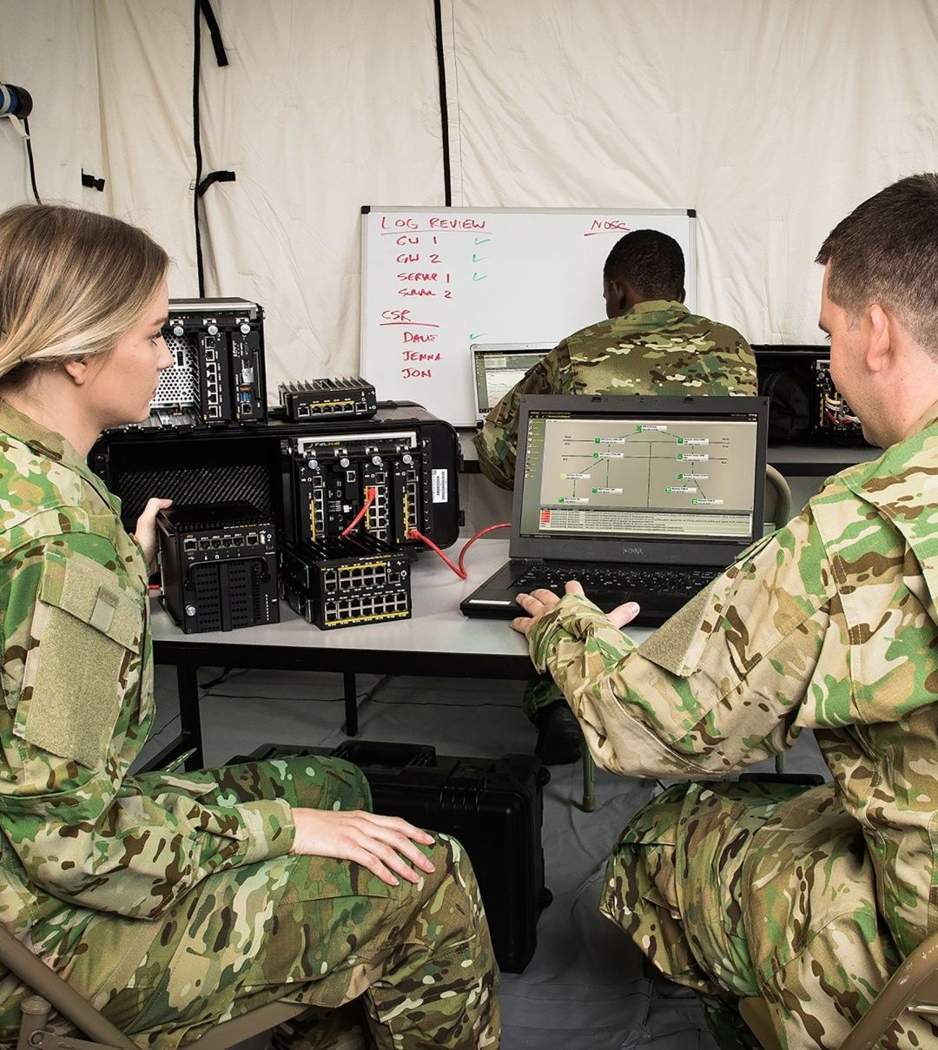
Communication
Advanced communication systems enable real-time information exchange across various levels of command.
They facilitate rapid decision-making and coordination.
Satellite communication networks ensure reliable and secure connectivity even in remote or hostile environments, overcoming traditional limitations of terrain or distance.
Encrypted messaging platforms and secure radio systems safeguard sensitive information, protecting against interception or cyber threats.
The digitalization has streamlined communication processes, enabling seamless integration of voice, data, and video transmission, enhancing awareness and collaboration among military personnel.

Slide 4
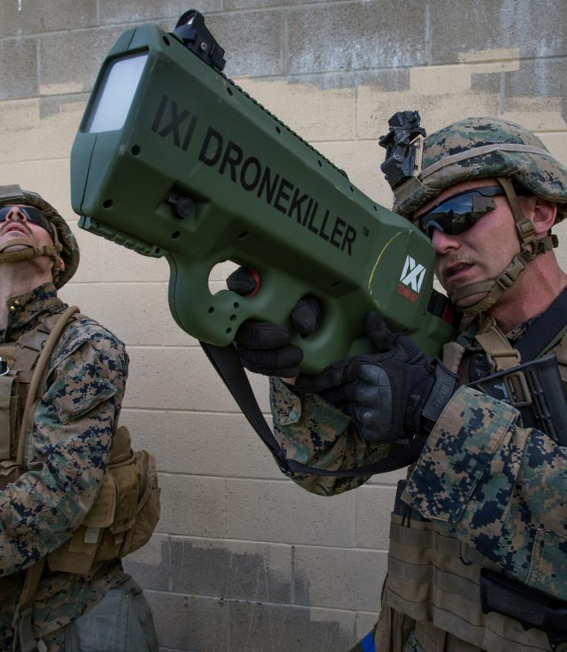
Precision Targeting
The development of precision-guided munitions (PGMs) proves monumental as it allows for accurate and precise targeting to enemy forces. This includes weaponry such as:
Guided missiles
Smart bombs
They are equipped with advanced guidance systems like GPS, laser, or infrared targeting.
Advanced targeting algorithms powered by artificial intelligence analyze vast amounts of data to identify and prioritize targets based on various factors such as:
Threat level
Importance
Potential collateral damage.
This enables military forces to make more informed decisions and execute precision strikes with minimal risk to friendly forces and civilians.

Slide 5

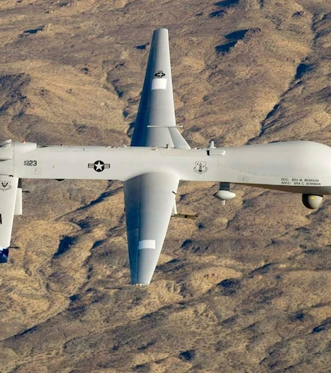
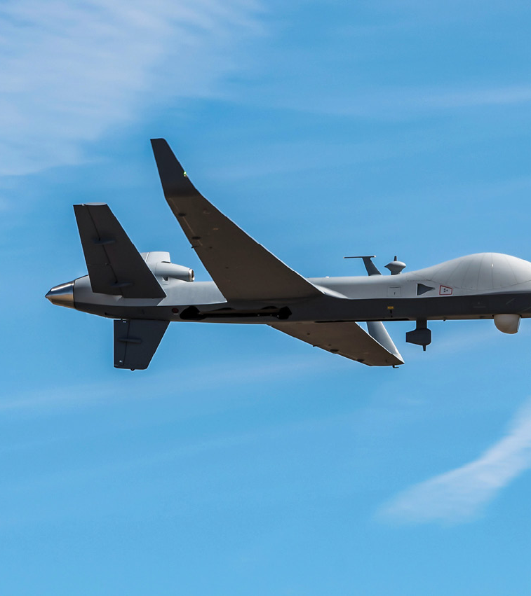
Situational Awareness
One significant advancement is the integration of sensor systems, including:
Radar
Sonar
Electro-optical/infrared (EO/IR) sensors
These continuously monitor the battlefield and gather data on enemy movements, terrain, and environmental conditions.
Satellite imagery and reconnaissance drones deliver high-resolution visual data, allowing military commanders to assess the battlefield’s changing conditions and identify potential threats or opportunities.
Advanced data fusion and analytics capabilities integrate information from multiple sources. This includes:
Sensors
Intelligence reports
Historical data
They generate comprehensive situational awareness pictures. This integrated view enables military leaders to understand the operational context fully and make well-informed decisions.

Slide 6
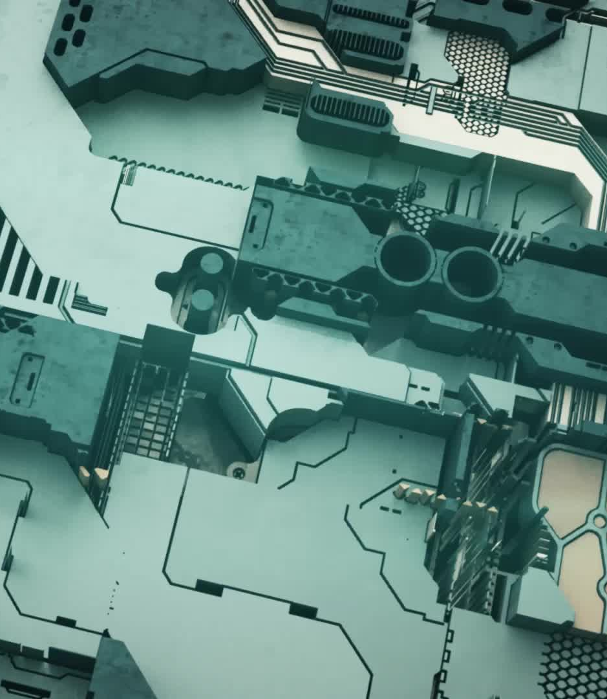
Cyberattack & Defense
Technology has been seen to steadily enhance and improve the cyber capabilities of attacks within the military. These enhancements include:
Advanced Cyber Weapons
Automation and AI
Cyber-Physical Attacks
Espionage and Intelligence Gathering
On the other side of the coin, technology has vastly improved cyber-defensive capabilities as well. The include elements such as:
Advanced Threat Detection
Encryption and Cryptography
Cyber Threat Intelligence
Continuous Monitoring and Incident Response

Slide 7
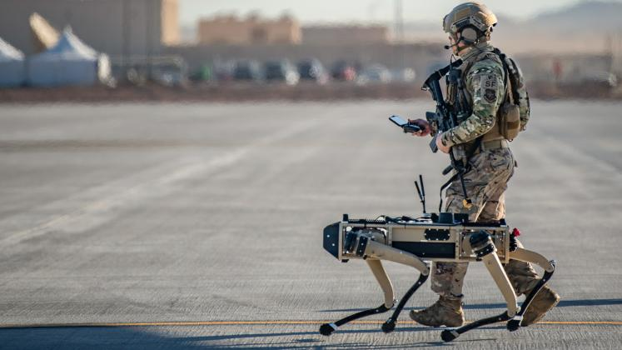
Computational
Just as much as every other aspect of technological warfare, computational devices have been prevalent throughout the eras of war. Computers have affected the technology in the military by bringing about:
Unmanned systems
Simulation and training
Command and control stations
Precision targeting
Chips in missiles are all computers that allow for tracking and remote control. Unmanned systems are powered by computer and artificial intelligence. Simulations and training are now powered primarily by computers.

Slide 8
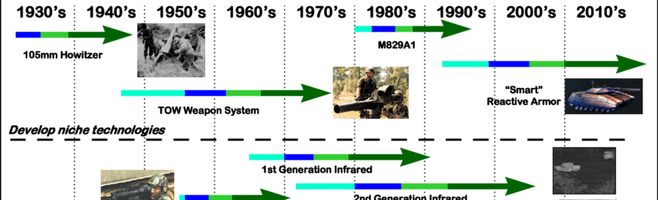
History of Technology in the Military
World War II saw vast improvements, never before seen by any party. Since the war was split into theaters, every side had a taste of new technology, whether mechanical and physical, or computational and coded.
The height of the war brought about new technologies such as:
Radar & sonar
Encryption and decryption
Nuclear weapons
Radar and sonar had been introduced to Allied and Axis forces that allowed for improved reconnaissance and targeting.
Encryption and decryption allowed for improved espionage and communication across all boards.
Nuclear weapons were introduced, though not powered by computers yet, they gave way to be innovated and experimented on with hardware and technologies of the sort.

Slide 9
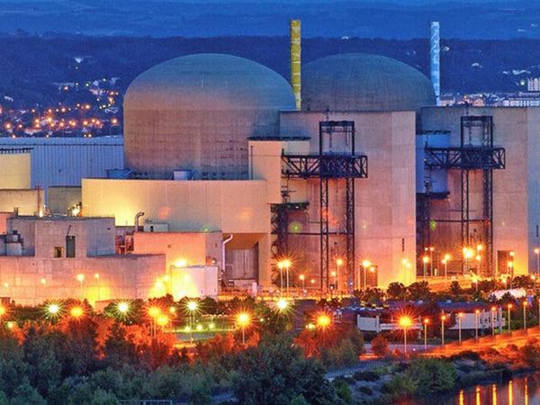
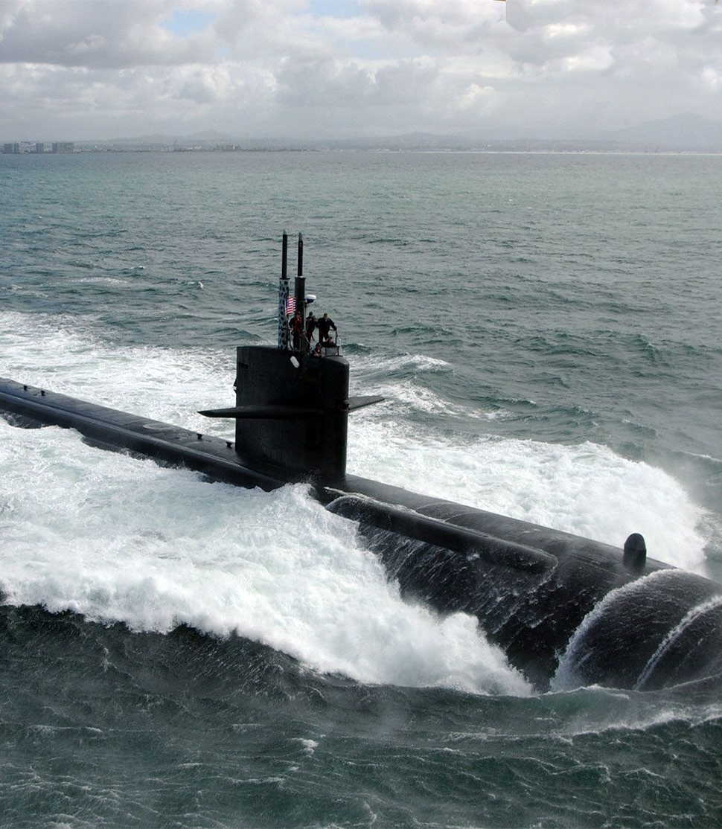
Cold War
The Cold War was when nuclear warfare was at its peak. Espionage and information gathering was the main source of fighting. Nuclear weapons had finally been equipped with hardware that would automate detonation, balance levels of radioactive elements, and/or calculate distance for launch. Nuclear missiles were to be launched by submarine using sophisticated technology such as tracking devices and computers that calculated these large continental distances.
Satellites, a very complex machine that involves more hardware than any server I’ve seen, were utilized to expand upon surveillance and spying.
The era of espionage, as the Cold War is primarily known for, was vastly expanded upon. This allowed for more methods of encryption and decryption that massively improved upon since World War II.

Slide 10
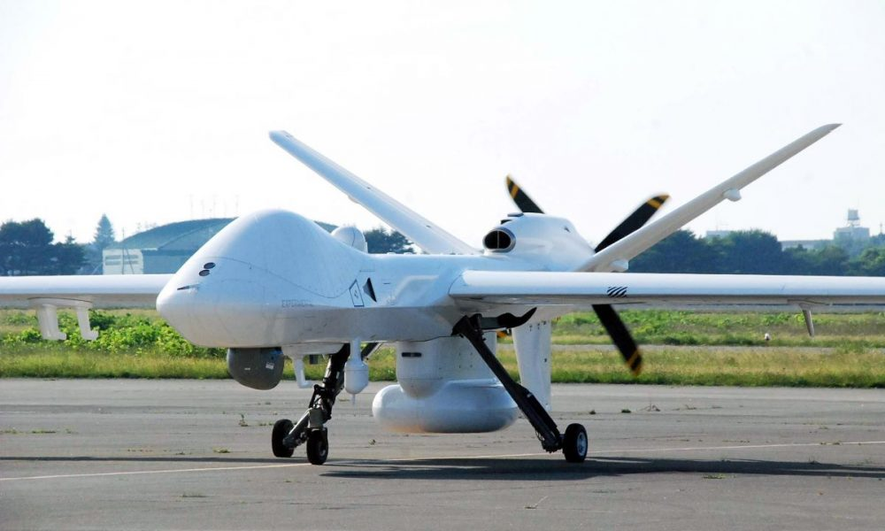
Post-Cold War
The introduction of the internet cannot go unnoticed when speaking on technological advancements for this period. This allowed for even more methods of communication and intelligence gathering. This laid down blueprints for future computational advancements as well.
The media can very well be seen affecting technology. Leaks into military operations and their advancements in tech would go on to incite a race to see which country could become the most advanced – the fastest. Among these, this era introduced technological advancements in the military such as:
Precision targeting
Stealth Technology
UAVs
Cyber Warfare

Slide 11
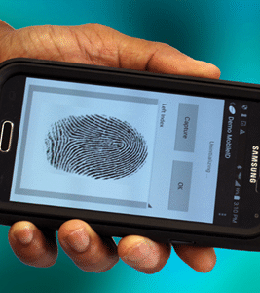
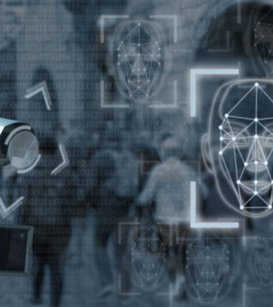
The Global War on Terror
The war on terror introduced improvements to aforementioned technologies as well as new introductions to not only the battlefield but base operations.
Surveillance and reconnaissance technologies were vastly improved. Satellite imagine was now utilized more than ever; UAVs were improved with responses to their imaging.
Biometric identification and analysis allowed for improved security as well as tracking and locating high-level targets.

Slide 12
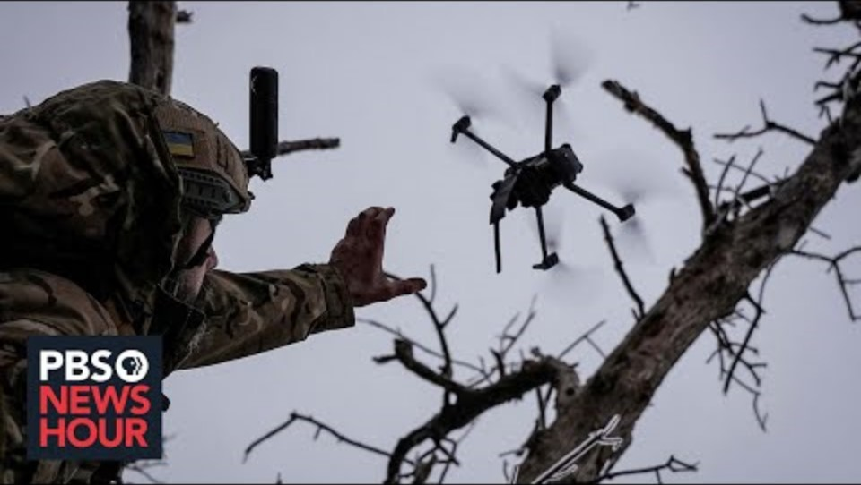
The Drone War
This particular period is self-explanatory. Introduction of artificial intelligence into the battlefield allowed for manipulation of drones and robots. There was an introduction of:
Remote-controlled reconnaissance drones
Ground remote-controlled bomb disarmers
Surveillance drones
Explosive targeting drones
Small espionage drones

